Slide 1

Prediction of Diabetes using Ensemble Techniques
TEAM - 5
SARATH CHANDRA (MT 19037) MANI KUMAR (MT 19065)
NIKHIL KOLLA (MT 19123) MURALI KRISHNA (MT 19132)

Slide 2
Introduction
Diabetes is a condition where the glucose level rises in the body to such an extent that pancreas fails to produce sufficient amounts of insulin to neutralise it.
India is referred to as “Diabetes Capital of the world” as 74 million people were affected in 2017.
If unidentified and not diagnosed, Diabetes will be one of the most known chronic diseases, and will lead to complications in health.

Slide 3
contd..
There are two types of Diabetes conditions :
Type 1 : 5-10 % of total cases, cells cannot respond to insulin secretion
Type 2 : 90-95% of total cases, Insulin cannot be produced because of pancreas failure.
As most of the biomedical data is being available freely, we need to provide solutions to detect whether a person is diabetic or not by using advanced methods.
So, in this research we are trying to classify whether a person is diabetic or not based on the person’s data (age, gender, bmi, insulin levels,glucose levels,skin-thickness,pedigree,bp) using Ensemble of Machine Learning techniques.

Slide 4
Existing Methods
Rohan bansal and et al used K Nearest Neighbor classifier for the detection of diabetes. The features for prediction are selected using PSO optimisation method and achieved 77% prediction accuracy.
A class wise KNN (C KNN) also implemented where normalization of data is done on diabetes data and achieved nearly an accuracy of 78.16%
Lin Li et al proposed a formulation of voting classifier which is called as weight- adjusted classifier. This method when used on diabetes dataset, they achieved prediction accuracy of 77%

Slide 5
contd..
Priyadarshini et.al predicted whether a person is suffering with diabetes or not by using all available diabetes dataset and inferences are drawn. They have also compared between extreme learning classifiers and neural networks.
A study also carried where both supervised and unsupervised methodologies are carried out together to diagnose the diabetes.
Prema and et.al used different classifiers on gestational diabetes mellitus (GDM) and obtained nearly 86.7% accuracy. They have used Naive Bayes, Decision trees and Random forests.

Slide 6
Research Base paper
The research paper we used is available under the name “Prediction of Diabetes using Ensemble Techniques” by Prema N S and et.al
They have used PIMA Indian Diabetes Dataset which consists medical data of 768 patients
Out of 768 records, 500 are of non diabetic patients records and remaining 268 records are about diabetic patients. As we can observe the data is heavily imbalanced.

Slide 7
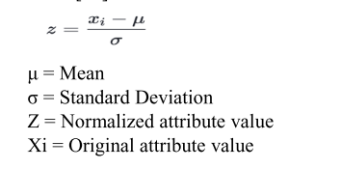
contd..
The attributes of the data are :- Number of times pregnant, plasma glucose concentration, blood pressure, skin thickness, insulin, bmi, diabetes pedigree function and age . Total 8 features are used to classify the patient as diabetic or not.
As different features have different range of values, and machine learning techniques are highly biased to large numbers, they have done feature normalization.
The normalization they carried is Z score
normalization

Slide 8
contd ...
After Standardization of data, they have applied different classifiers on the data and created a meta-classifier which is ensemble of all classifiers.
The different classifiers they considered are KNN, Logistic Regression, Naive Bayes, Gaussian Process,SVM, adaboost and Random forests. All these classifiers are trained separately with 70% of total data and results are noted by using remaining 30% of total data.
The accuracies for different classifiers are in the range between 74 to 81 %.
The final accuracy using ensemble (voting ) classifier is around 80.95%

Slide 9
Materials and Methods
We have also used same PIMA Indian Diabetes Dataset, which is freely available in kaggle site.
If we observe, the dataset is highly imbalanced so we used Upscaling techniques to increase number of samples of minority class.
When we have done Exploratory Data Analysis (EDA), we observed that certain features have incorrect values, say zero to blood pressure and bmi . So we carried out imputation technique to fill those values (Novel , as this problem is not addressed in the research paper)
We have also done Z score normalization to all the features to make all the features to be in given range.

Slide 10
contd..
In addition to the classifiers like Naive bayes, Decision trees, Random forests, SVM as proposed in the research paper, we also used Gradient Boosting and XG Boost classifiers (Novel) to address the problem.
We have used 70% of available data for training and remaining 30% data is used for testing. In adding to this to determine optimal hyper parameters of different classifiers, we used 5 fold Cross validation using GridSearchCv.
We have considered Precision, Recall, F1 score, Specificity and accuracy as evaluation techniques for each classifier.
We have considered top 3 performing classifiers and constructed a voting classifier and results are noted.

Slide 11
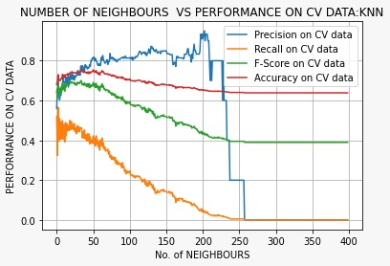
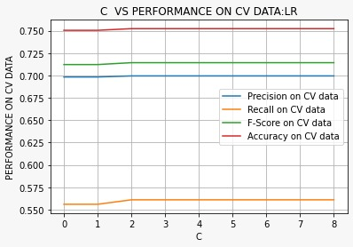
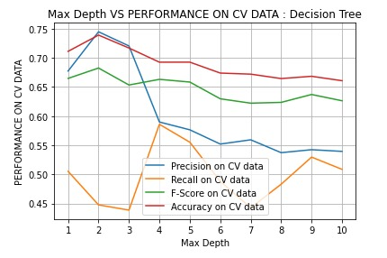
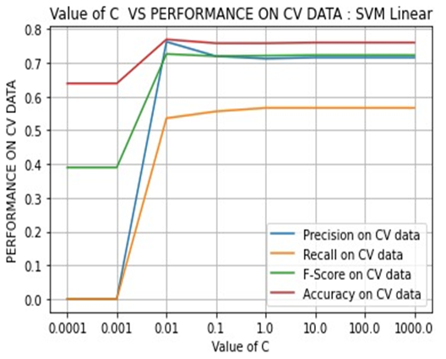
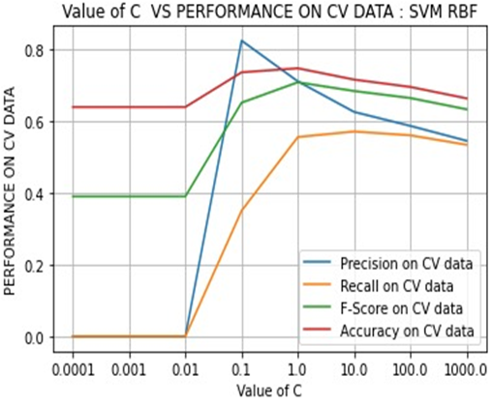
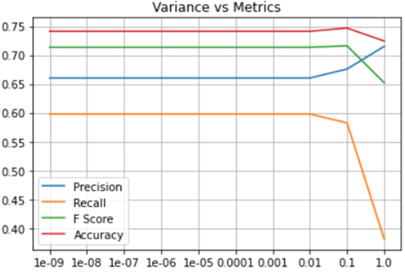
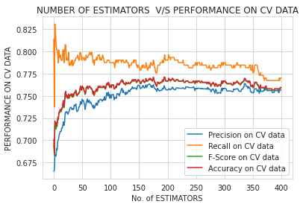
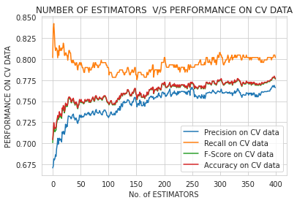
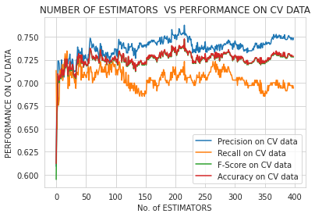
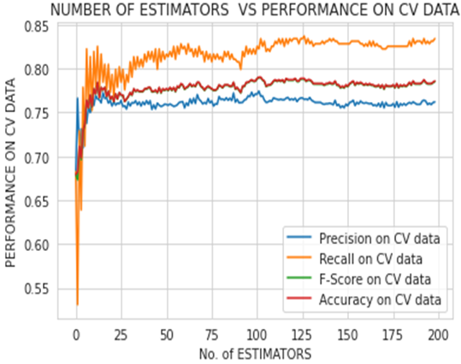
Results on CV data
K vs Metrics(KNN) C vs Metrics(L’Regression) Depth vs Metrics(DTrees) C vs Metrics(Linear SVM) C vs Metrics(RBF SVM)
Estimators vs Metrics (GBDT)
Variance vs Metrics (Naive Bayes)
Estimators vs Metrics (Xgboost)
Estimators vs Metrics (Adaboost)
Estimators vs Metrics (Random Forests)

Slide 12
S.No | Model Used | Accuracies on Test data in published Paper | Accuracies on Test data achieved by us
1 | KNN | 74.89 | 75.75
2 | Logistic Regression | 75.75 | 77.92
3 | Naive Bayes | 73.59 | 76.623
4 | Decision Trees | 71.86 | 72.72
5 | Gaussian Process | 74.02 | 77.22
6 | SVM Linear | 70.99 | 78.78
7 | SVM RBF | 75.32 | 75.75
8 | Xgboost | Not applied in paper | 78.78
9 | Gradient boosting | Not applied in paper | 79.22
10 | Adaboost | 73.16 | 79.62
11 | Random Forest | 75.75 | 80.08
12 | Voting Classifier | 80.95 | 83.18

Slide 13
Discussion & Conclusion
We have used 5 fold and 10 fold CV for hyper parameter tuning of different classifiers and best classifier is decided based on accuracy metric.
Optimal Hyper parameters :
Logistic regression (C) : 3, KNN (k) : 34, For decision trees (max-depth) : 2, and C values for Linear and RBF SVM is 0.01 and 0.1 respectively.
For gaussian naive bayes, we are able to achieve best results when variance is 0.1.
In case of random forest, gradient boosting, adaboost, xgboost classifiers we obtained optimal number of base estimators to be 181, 140, 74, 62

Slide 14
contd..
The best performing classifier on test data is Random Forest.
Random forest model has least amount of bias and least amount of variance, as it is combination of many base learners which are high bias and therefore enabling the model to produce the best results.
If the size of the data becomes surplus as a part of future work, we can implement deep-learning based models which introduce non-linearity thus improving the overall performance.

Slide 15
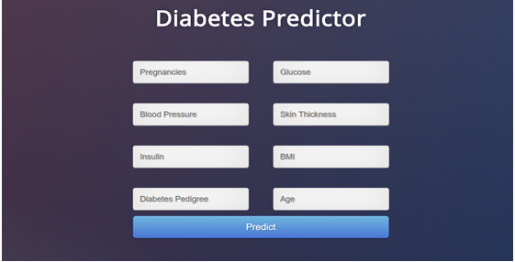
Deployment
In order to make this model available for common people, we also deployed our model (voting classifier-majority vote among predictions of top-3 performing models). It consists of User Interface to take all the input features and predicts the probability of a person being diabetic or not.

